Slide 1

SMART AGRICULTURE SYSTEM

Slide 2
ABSTRACT:
Agriculture plays vital role in the development of economy in the country. In India about 70% of population depends upon farming.
One of the solution to this problem is smart agriculture by modernizing the current traditional methods of agriculture.
The highlighting features of this project includes smart control and intelligent decision making based on field data.

Slide 3
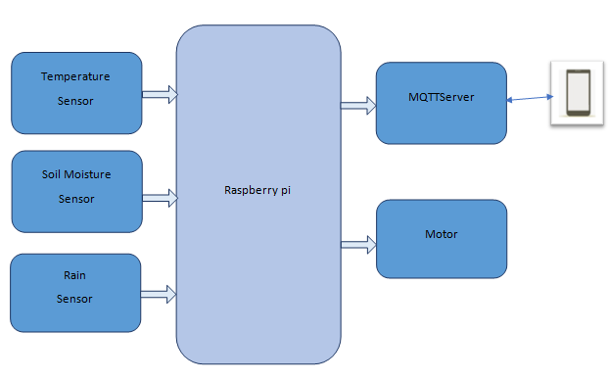
INTRODUCTION:

Slide 4
COMPONENTS:
Hardware Requirements:
Raspberry pi 3B
LM35 (Temperature Sensor)
Soil Moisture Sensor
Rain Sensor
L293D IC
PCF8591 IC
Software Requirements:
PUTTY
MQTT

Slide 5
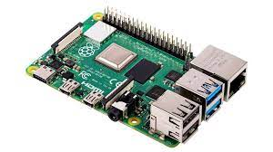
RASPBERRY PI
Raspberry Pi is the name of a series of single-board computers made by the Raspberry Pi Foundation, a UK charity that aims to educate people in computing and create easier access to computing education.
.

Slide 6
The Raspberry Pi 3B is a very cheap computer that runs Linux, but it also provides a set of GPIO (general purpose input/output) pins, allowing you to control electronic components for physical computing and explore the Internet of Things (IOT) such as home automation, Edge computing and many other industrial applications

Slide 7
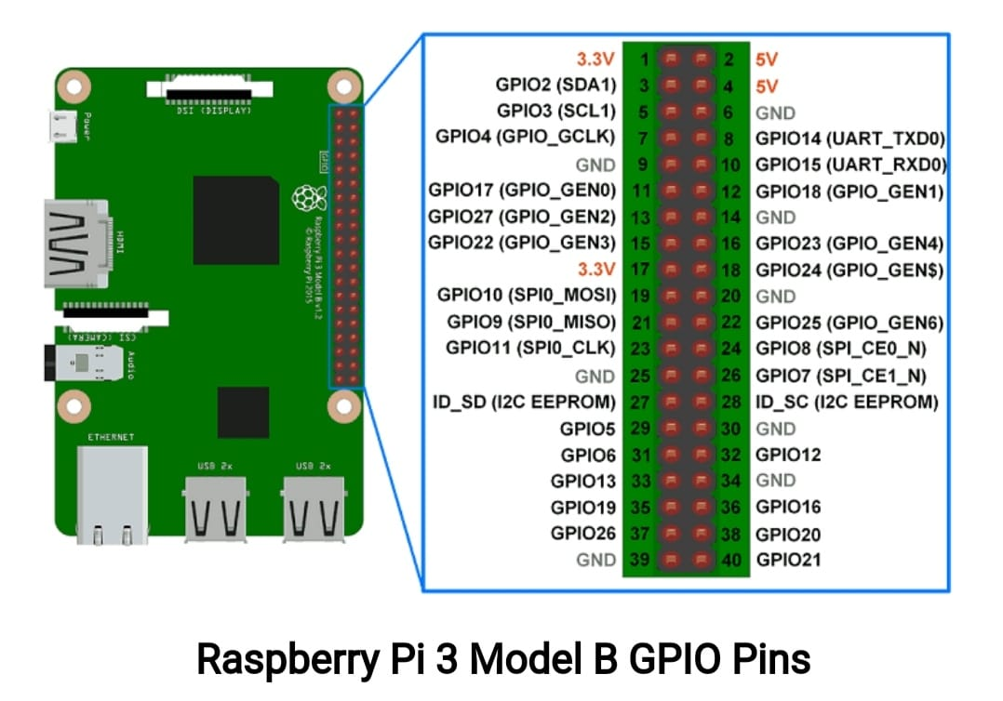

Slide 8
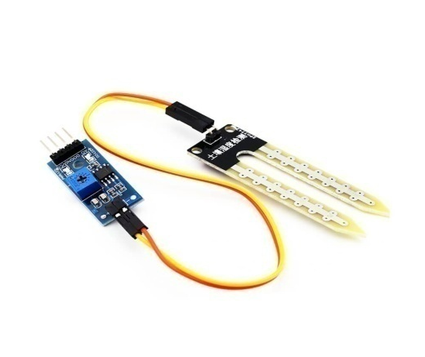
Soil Moisture Sensor
Soil moisture sensor is a sensor which senses the moisture content of the soil.
When the soil is dry, the current will not pass through it and so it will act as open circuit. Hence the output is said to maximum. When the soil is wet, the current will pass from one terminal to the other and the circuit is said to be short and the output will be zero.

Slide 10
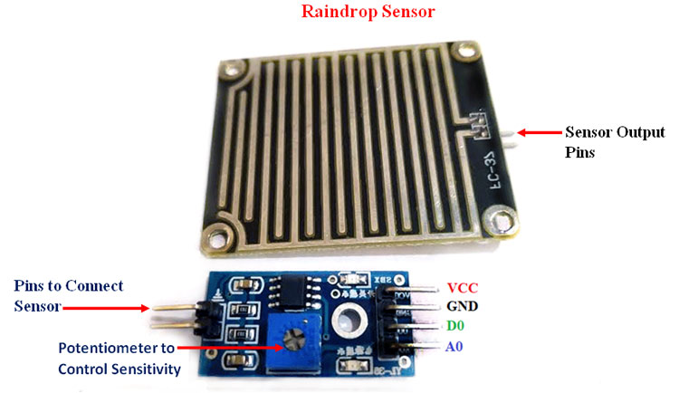
Rain sensor
A raindrop sensor is basically a board on which nickel is coated in the form of lines. It works on the principle of resistance.
If we apply a voltage between two strips ,it will be an open circuit never the less, when we expose this surface to the rain, the water that falls closes the circuit between the strips and different voltage can be measured.

Slide 12
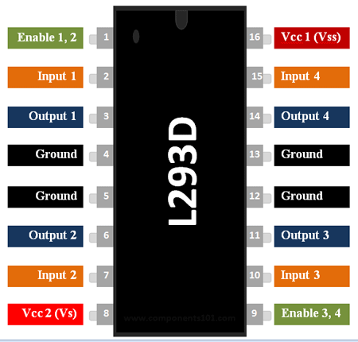
L293D( Motor Driving IC)
L293D IC is an integrated circuit chip which is usually used to control motors in autonomous robots. They act as an interface between raspberry pi in circuit and the motors in the circuit. These ICs are designed to control 2 DC motors simultaneously

Slide 13
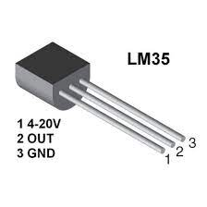
Temperature Sensor(LM35)
LM35 is a temperature measuring device having an analog output.
As temperature increases, output voltage also increase. tput voltage proportional to the temperature

Slide 14
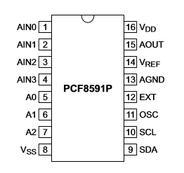
ADC
The PCF8591 is a single-chip, 8-bit CMOS data acquisition device with four analog inputs, one analog output and a serial I2C-bus interface.
The functions of the device include analog input multiplexing
based on 3 address lines( A0, A1, A2)

Slide 15
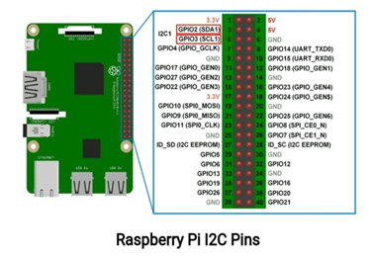
Software Requirements i2c
I2C (Inter Integrated Circuit) is a synchronous serial protocol that communicates data between two devices. It is a master-slave protocol which may have one master or many master generally used for communication over short distance. The I2C device has 7-bit or 10-bit unique address. So, to access these devices, master should address them by the 7-bit or 10-bit unique address. I2C is used in many applications like reading RTC (Real time clock), accessing external EEPROM memory. It is also used in sensor modules like gyro, magnetometer etc.It is also called as Two Wire Interface (TWI) protocol

Slide 16
Putty
PUTTY is a free and open-source terminal emulator, serial console and network file transfer application. It supports several network protocols, including SCP, SSH, Telnet, rlogin, and raw socket connection. It can also connect to a serial port.

Slide 17
MQTT
MQTT ( Message Queue Telemetry Transport) is a lightweight, publish-subscribe, machine to machine network protocol for Message queue/Message queuing service. It is designed for connections with remote locations that have devices with resource constraints or limited network bandwidth. It must run over a transport protocol that provides ordered, lossless, bi-directional connections—typically.
The MQTT protocol defines two types of network entities: a message broker and a number of clients. An MQTT broker is a server that receives all messages from the clients and then routes the messages to the appropriate destination clients. An MQTT client is any device (from a micro controller up to a fully-fledged server) that runs an MQTT library and connects to an MQTT broker over a network.

Slide 18
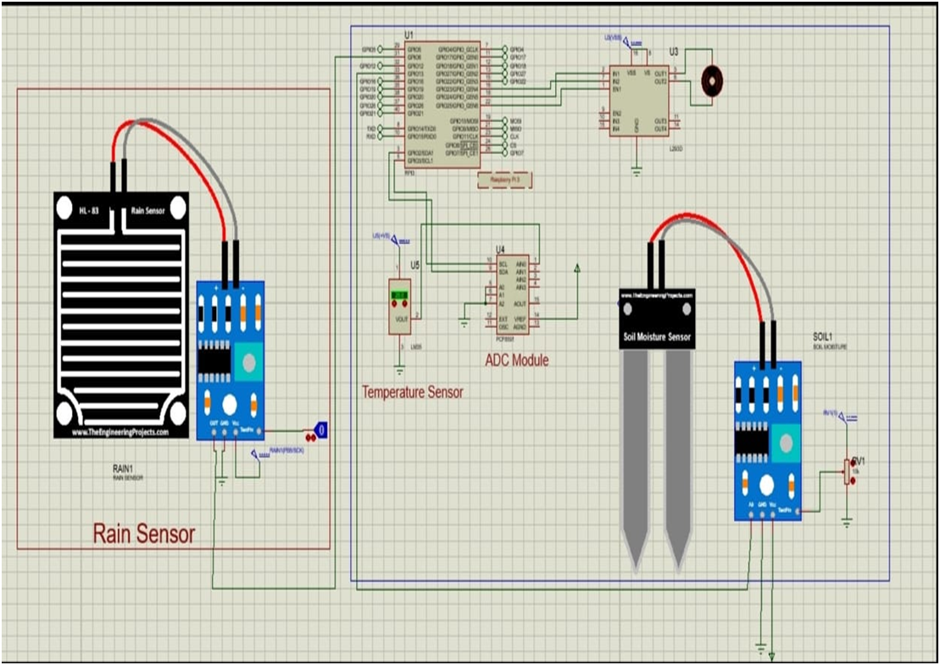
Working

Slide 19
The Circuit connections are made as shown. Generally the motor is on in normal condition to complete the water demand of crops.
As the Rain sensor is switching device activated by rainfall (It works on the principle of resistance), Rain sensor module allows to measure moisture via analog output pins and it provides digital output when a threshold of moisture exceeds.
When the Threshold of moisture exceeds, The Rain sensor gives 0 as digital output as a result the motor turns off to save the water.
Then it checks the water content in the soil using Soil moisture sensor.

Slide 20
Soil moisture sensor measures the water content of soil using the time or frequency of a pulse travelling between or returning to electrodes.
If the Soil moisture sensor detects the water content in soil then it sends the signal to turn off the motor, else it sends signal to turn on the motor.
Then it checks the surrounding temperature using the LM35 temperature sensor which works on the basic principle (As temperature increases the voltage across a diode increases at a known rate) diode.
LM35 contains a p-n junction diode inside it. By amplifying the voltage change, we can easily generate a voltage signal that is directly proportional to surrounding temperature.
From the data received from the sensors ,We determine the crops.

Slide 21
import paho.mqtt.client as mqttimport
RPi.GPIO as GPIO
import smbusimport time as t
mqttc=mqtt.Client()
mqttc.connect("test.mosquitto.org",1883,60)
mqttc.loop_start()
GPIO.setmode(GPIO.BOARD)
GPIO.setup(26,GPIO.OUT)
GPIO.setup(32,GPIO.OUT)
GPIO.setup(36,GPIO.OUT)
Motor1A = 18 #24
Motor1B = 16 #23
Motor1E = 22 #25
bus = smbus.SMBus(1)
ADDRESS1 = 0x48
def reading1():
a= bus.read_byte(ADDRESS1)
return a
GPIO.setup(31,GPIO.IN)
GPIO.setup(33,GPIO.IN)
GPIO.setup(Motor1A,GPIO.OUT)
GPIO.setup(Motor1B,GPIO.OUT)
GPIO.setup(Motor1E,GPIO.OUT)
x="Motor on“
y="Motor off"

Slide 22
while True:
temp = reading1()
temp = float(temp)
temperature = ((temp / 256)* 5.13 * 1000/10)
temperature = int(temperature)
if GPIO.input(31)==1:
if GPIO.input(33)==1:
GPIO.output(Motor1A,GPIO.HIGH)
GPIO.output(Motor1B,GPIO.LOW)
GPIO.output(Motor1E,GPIO.HIGH)
(result,mid)=mqttc.publish("paho/old123","*Rain not detected\n*Soil is dry\n*temperature in degree celsius= %d'C\n*Motor on"%temperature,2)
print("*Rain not detected \n*Soil is dry")
print("*temperature in degree celsius= %d'C"%temperature)
print("*Motor on")
else:
GPIO.output(Motor1E,GPIO.LOW)
(result,mid)=mqttc.publish("paho/old123","*Rain not detected\n*Soil is wet\n*temperature in degree celsius= %d'C\n*Motor off"%temperature,2)
print("*Rain not detected \n*Soil is wet ")
print("*temperature in degree celsius= %d'C"%temperature)
print("*Motor off")
else:
GPIO.output(Motor1E,GPIO.LOW)
(result,mid)=mqttc.publish("paho/old123","*Rain is detected\n*temperature
in degree celsius= %d'C\n*Motor off"%temperature,2) print("*Rain is detected")
print("*temperature in degree celsius is %d'C"%temperature)
print("*Motor off")
print("\n\n")
t.sleep(2)

Slide 23
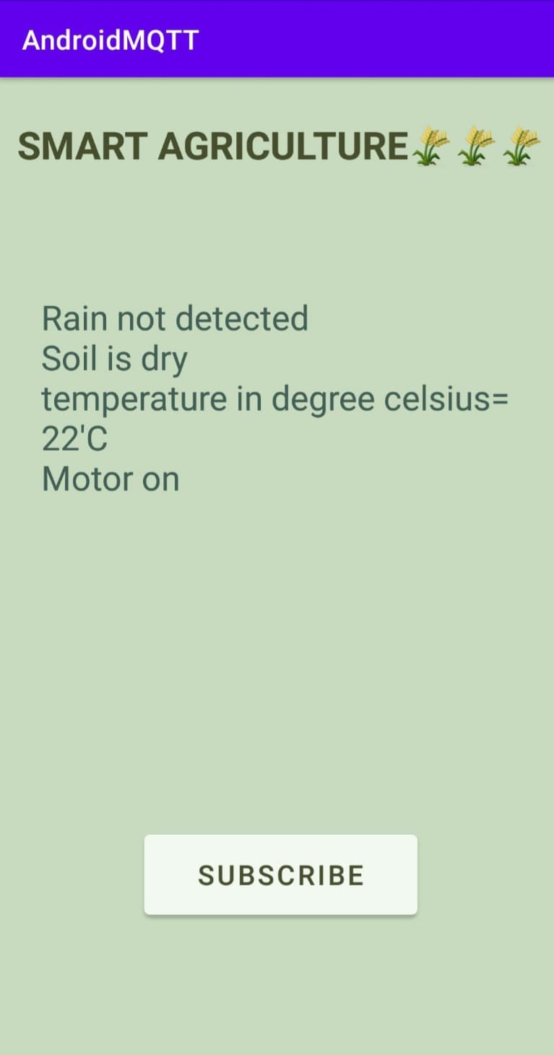
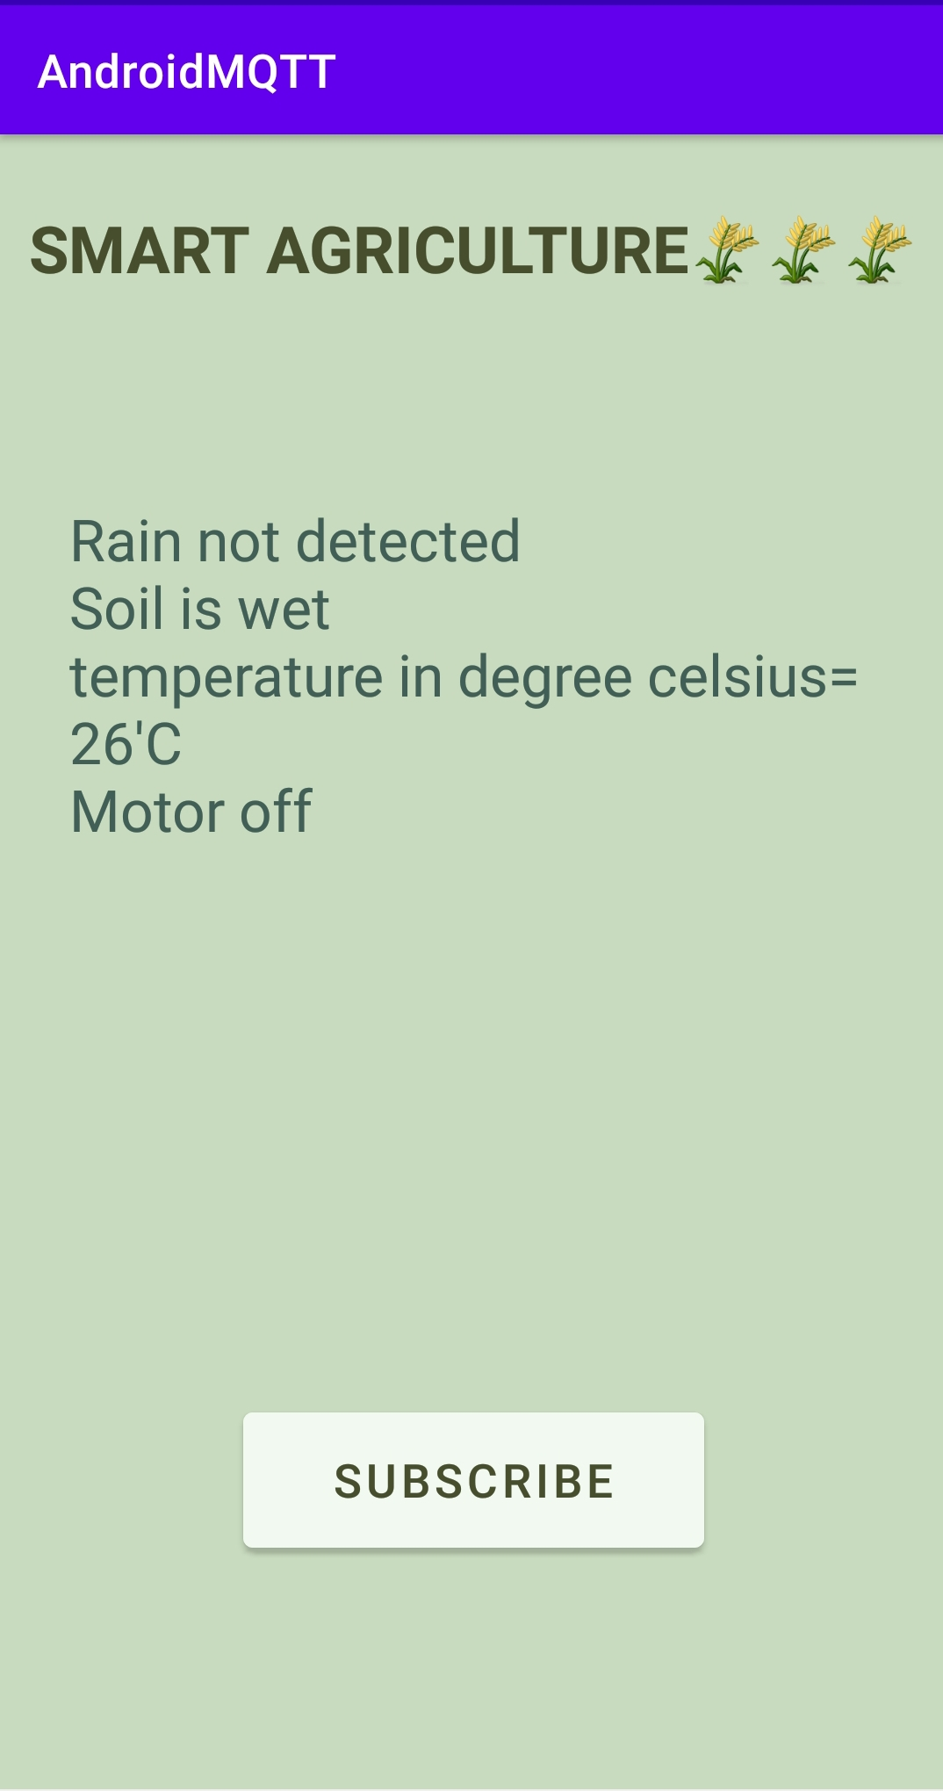
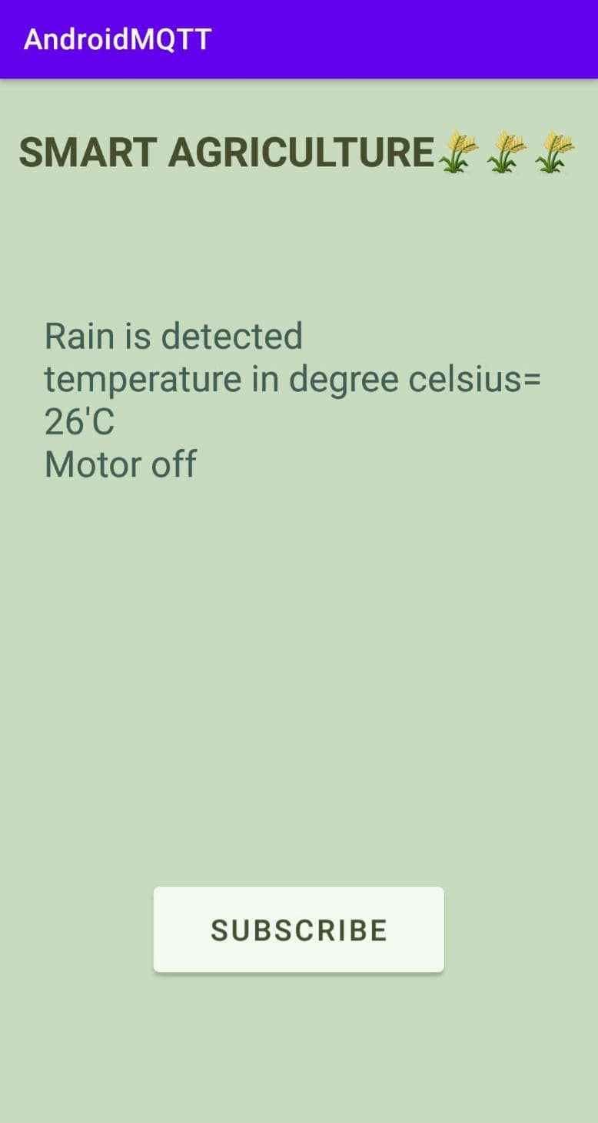
Result

Slide 24
